Slide 1
A Web App to Monitor State-Machines at Run-Time

Slide 2







Meet the Team
Ed Friesema
Julien Flores
Shizhao Wang
Devon Erb
Michael Corona
Leslie Ordonez
Maurice Martinez

Slide 3
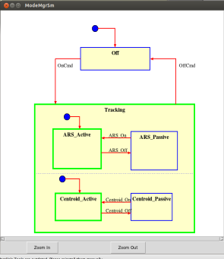
Current JPL Monitoring Process
Model.qm
Monitoring is used for testing state behavior for a variety of JPL systems
including flight software
Python GUI generated from a UML Statechart
Renders basic graphics
Highlights current active state
Uses a socket for IO
JPL
Autocoder
C code for
state machine
Python code for
state machine
Target Machine
Application
being tested for
state behavior
Python App GUI
STDIO
Socket
Notes:
Briefly explain the python widget generated from a UML Statechart they currently have and pipeline they use
Explain the benefits of this next generation state-machine run-time monitoring web tool. It should display at minimum the currently active state and give additional info about the run-time state of the running target state-machine. (Explain why.. what do they use this for.. to for unit testing of their systems like flight applications 2014 R&TD Demo Controller & 2010 Ares Rocket Flight Software Requirements Verification )
Describe a few benefits of using this system like
possibility of monitoring multiple state machines
possibility of supporting multiple users at a time
highlight active state, path to state, state of guard, last event, timeline GUI
display actions

Slide 4

Our Implementation
Web app to render graphics
Reads from XML model of machine
Not reliant on a specific Autocoder
Send events between generated machine and GUI
Quantum Leaps
open source
model based design tool
Model.qm
Web Browser App

Slide 5
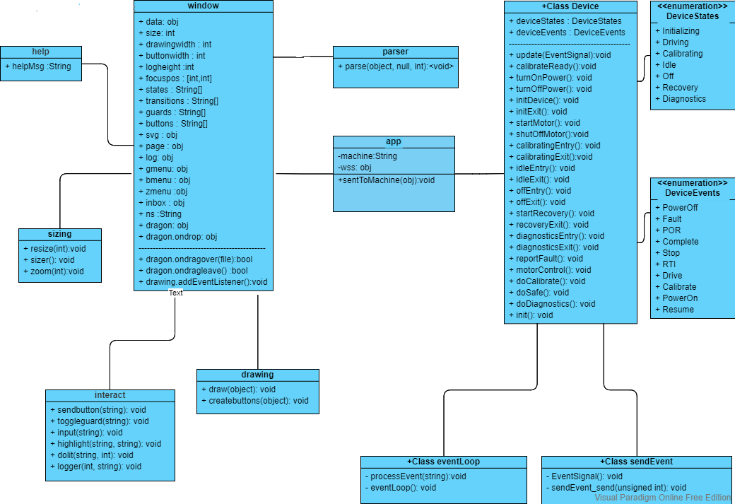
Web Application UML

Slide 6
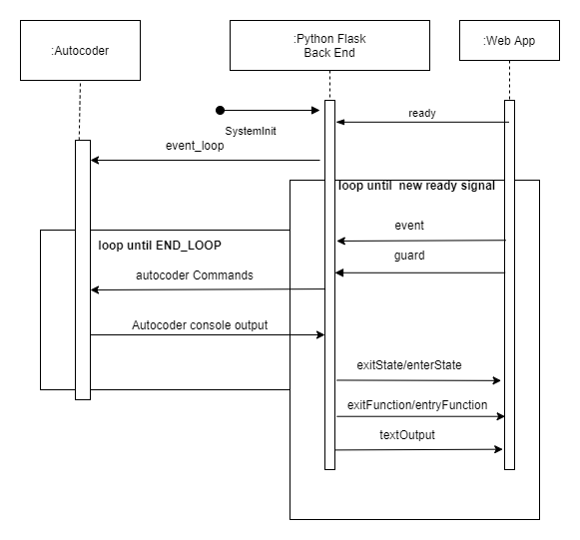
Web Application Sequence Diagram

Slide 7
Message Sending
Our primary goal in our design choices was for our web app to be user friendly and easily extended by other developers.
JSON as intermediary language
Back End:
Nodejs
Express
{"type":"ready"}
{"type":"event", "name":"PowerOn"}
{"state":"Off":"enter":false}
{"state":"On":"enter":true}
{"state":"Initializing":"enter":true}
Front End:
HTML
JavaScript

Slide 8
Live Demo

Slide 9
Features
Web Page
Diagram
Help page
Drag and drop
QM file parsing
Dynamic buttons
Log window
Responsive layout
Diagram drawing
Zooming controls
Active state highlighting
Auto scroll to entered state
Guard status display
Separate elements (no redrawing)

Slide 10
Acknowledgements
Special thanks to Mr. Garth Watney and Mr. Leonard Reeder of NASA’s Jet Propulsion Laboratory.
They made the time to check in on us weekly; And in helping us understand event-driven programming, their ideas, and suggestions on how to approach the build of this project.
Thank you, Dr. Stefik, for recommending this project and guiding us through the team building and software engineering process.

Slide 11
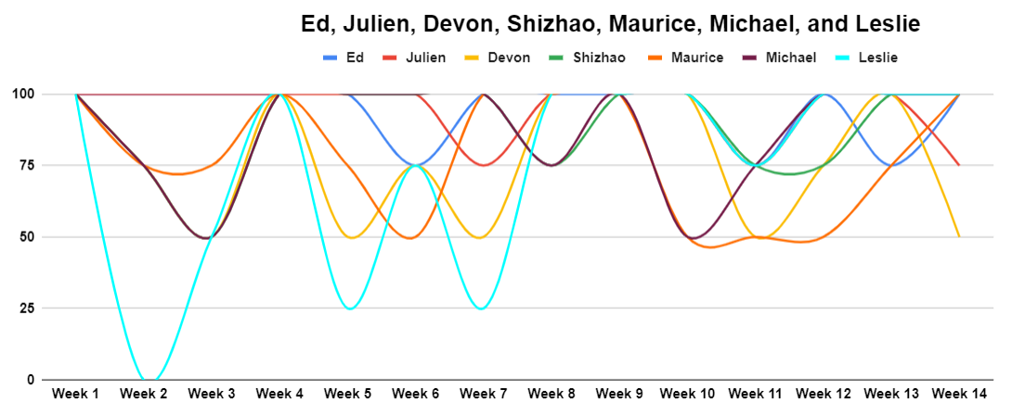
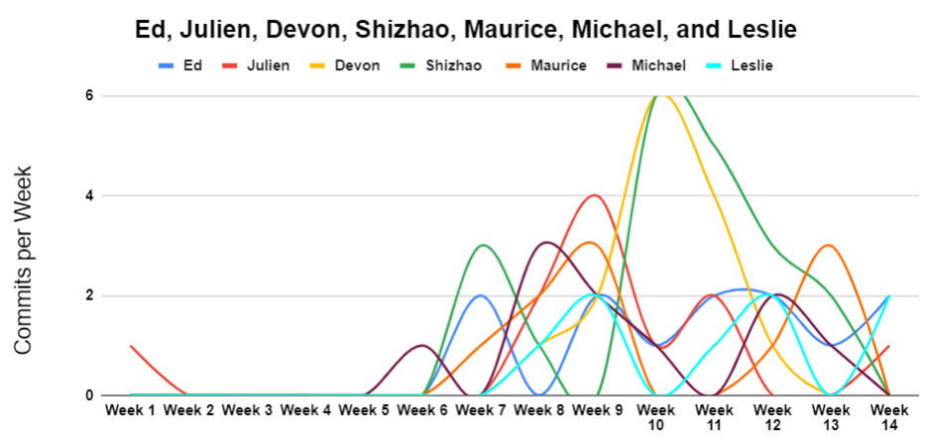
Team Contribution
The top chart shows the percentage of tasks completed each week.
The bottom chart shows the number of commits per week.
Besides meeting weekly our team also met with two JPL engineers 9 separate times to discuss design and implementation choices.

Slide 12

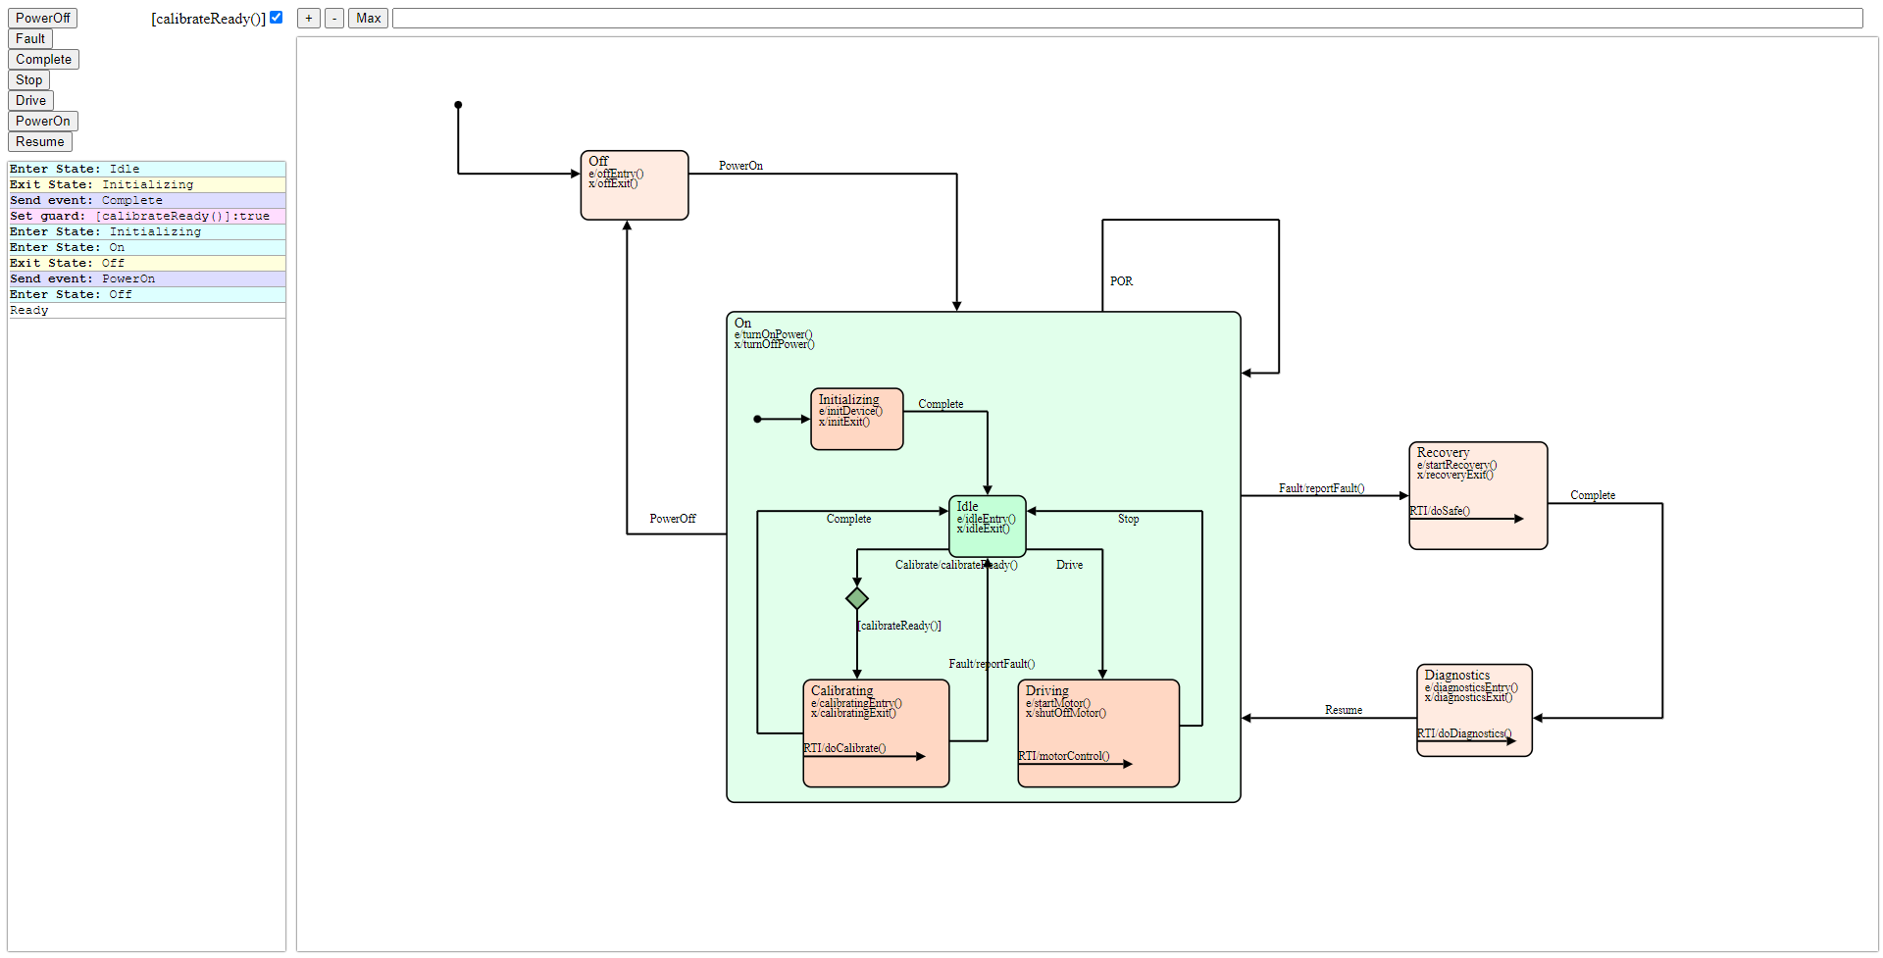
JPL State Machine Monitor GUI
Ed Friesema | Julien Flores | Shizhao Wang
Devon Erb | Michael Corona | Leslie Ordonez | Maurice Martinez
Application:
Our system is built around the NSM autocoder developed in C++ by the UNLV student team of Reynolds B et al.(GitHub - JPL-UNLV-CS-2021/nsm: NSM State Machine). Our goal was to use this system as the core of a web-based Python Flask application to serve a simple, intuitive, and flexible graphical interface for loading and interacting with state machines specified in either C++ or the QP framework XML format for representing UML hierarchical state machine(HSM) designs.
Introduction:
We are presenting a containerized web application that displays a finite state machine(FSM) for run-time execution testing and graphical status monitoring. The system uses Docker so that it can be installed and run on a wide variety of platforms. The interactive graphic interface of our web app enables the developer to experiment and see how a system performs under all possible conditions.
What is a finite-state machine (FSM)?:
State machines represent an event-driven system. Those events and the possible guard settings determine FSM behavior. The FSM is a C++ program run by the backend server which emulates the state machine operation. It parses the XML state machine description. Then receives event triggers from the event window and generates the triggered state transitions, exit and entry functions.
Future directions:
The entire project was built with standard open-source web technologies to help ensure that the system will run a wide variety of platforms. This also ensures future improvement or additions to the project can be done using commonly used programming languages.

